Slide 1

INSTITUTE - UIE
DEPARTMENT- ACADEMIC UNIT-2
Bachelor of Engineering (Computer Science & Engineering)
Subject Name: Introduction to Problem Solving
Code:22CSH-101
Searching and Sorting
DISCOVER . LEARN . EMPOWER

Slide 2

OBJECTIVES
The course aims to provide exposure to problem solving with programming
The course aims to raise the programming skills of students via logic building capability
With the knowledge of C language students would be able to model real world problems
OBJECTIVES

Slide 3



CO Number | Course Outcome
CO1 | Remember the concepts related to fundamentals of C language, draw flowcharts and write algorithm/pseudocode.
CO2 | Understand the way of execution and debug programs in C language.
CO3 | Apply various constructs, loops, functions to solve mathematical and scientific problem.
CO4 | Analyze the dynamic behavior of memory by the use of pointers.
CO5 | Design and develop modular programs for real world problems using control structure and selection structure.

Slide 4

Scheme of Evaluation

Slide 5
Content
Searching and Sorting
Types of Searching with Examples
Definition of Sorting
Types of Sorting with Examples
References

Slide 6
Searching
It is a method for finding a target value within a list. It sequentially checks each element of the list for the target value until a match is found or until all the elements have been searched.

Slide 7
Searching Algorithms are designed to check for an element or retrieve an element from any data structure where it is stored.
Based on the type of search operation, these algorithms are generally classified into two categories:
1. Sequential Search: In this, the list or array is traversed sequentially and every element is checked.
For example: Linear Search.
2. Interval Search: These algorithms are specifically designed for searching in sorted data-structures. These type of searching algorithms are much more efficient than Linear Search as they repeatedly target the center of the search structure and divide the search space in half.
For example: Binary Search.
Types
of
Searching

Slide 8
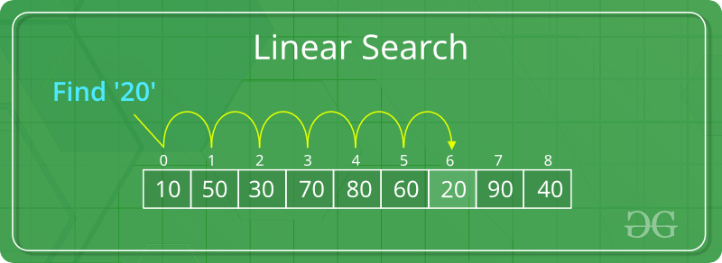
1. Linear Search: In this, the list or array is traversed sequentially and every element is checked.
Example: Search to find the element “20” in a given list of numbers
Linear search: Input : arr[] = {10, 50, 30, 70, 80, 60, 20, 90, 40}
Element to be search in x = 20;
Output : 6th Element. x is present at index 6
Linear Search
A simple approach is to do linear search, i.e
Start from the leftmost element of arr[] and one by one compare x with each
element of arr[]
If x matches with an element, return the index.
If x doesn’t match with any of elements, return -1.

Slide 9
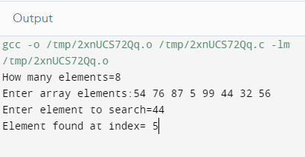
#include<stdio.h>
int main()
{
int a[20],i,x,n;
printf("How many elements=");
scanf("%d",&n);
printf("Enter array elements:");
for(i=0;i<n;++i)
scanf(“\t%d",&a[i]);
printf("nEnter element to search=");
scanf("%d",&x);
for(i=0;i<n;++i)
if(a[i]==x)
break;
if(i<n)
printf("Element found at index= %d",i);
else
printf("Element not found");
return 0;
}
Example in
C programming
Code

Slide 10
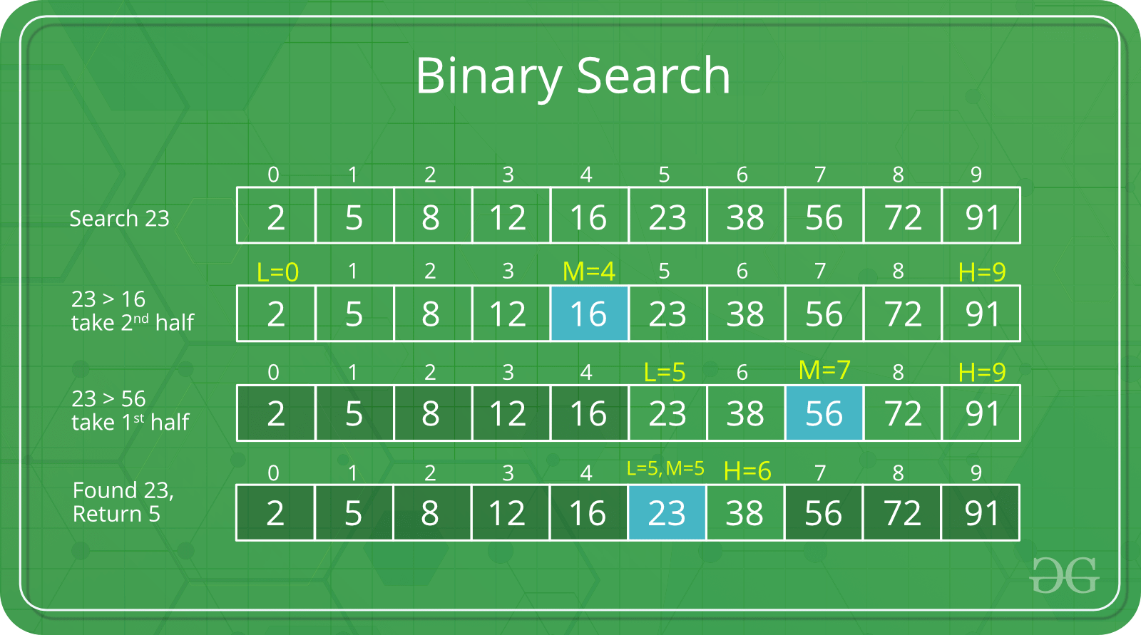
2. Binary search: Search a sorted array by repeatedly dividing the search interval in half. Begin with an interval covering the whole array. If the value of the search key is less than the item in the middle of the interval, narrow the interval to the lower half. Otherwise narrow it to the upper half. Repeatedly check until the value is found or the interval is empty.
Example: Binary Search to find the element “23” in a given list of numbers
Binary Search

Slide 11
Example in C programming Code
Ignore half of the elements just after one comparison.
Compare x with the middle element.
If x matches with middle element, we return the mid index.
Else If x is greater than the mid element, then x can only lie in right half sub array
after the mid element. So we recur for right half.
Else (x is smaller) recur for the left half.
Binary search program in C
#include <stdio.h>
int main() { int c, first, last, middle, n, search, array[100];
printf("Enter number of elements\n"); scanf("%d", &n);
printf("Enter %d integers\n", n);
for (c = 0; c < n; c++) scanf("%d", &array[c]);
printf("Enter value to find\n"); scanf("%d", &search);

Slide 12
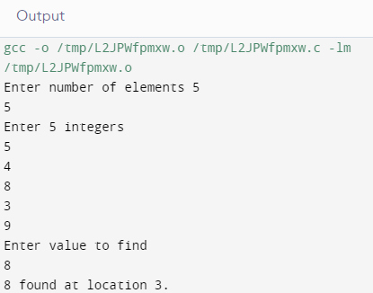
first = 0; last = n - 1; middle = (first+last)/2;
while (first <= last) { if (array[middle] < search) first = middle + 1; else if (array[middle] == search) { printf("%d found at location %d.\n", search, middle+1); break; } else last = middle - 1;
middle = (first + last)/2; }
if (first > last) printf("Not found! %d isn't present in the list.\n", search);
return 0 ;
}
Example in
C programming
Code

Slide 13
Sorting:
Sorting is the method of arranging the elements in particular order mostly either ascending or descending order.
Types of sorting :
Bubble Sort.
Selection Sort.
1. Bubble Sort: It is the simplest sorting algorithm that works by swapping adjacent elements if they are in the wrong order.
Example: Take an array of numbers ” 5 1 4 2 8″, and sort the array from lowest number to greatest number using bubble sort. In each step, elements written in bold are being compared. Three passes will be required;
First Pass: ( 5 1 4 2 8 ) → ( 1 5 4 2 8 ), Here, algorithm compares the first two elements, and swaps since 5 > 1.
( 1 5 4 2 8 ) → ( 1 4 5 2 8 ), Swap since 5 > 4
( 1 4 5 2 8 ) → ( 1 4 2 5 8 ), Swap since 5 > 2
( 1 4 2 5 8 ) → ( 1 4 2 5 8 ), Now, since these elements are already in order (8 > 5), algorithm does not swap them.
Sorting
And Types

Slide 14
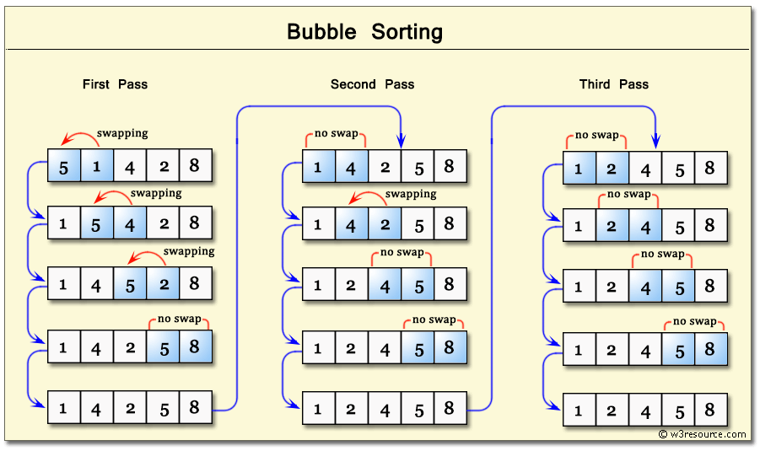
Bubble Sort Diagram

Slide 15
Bubble Sort
Second Pass
( 1 4 2 5 8 ) → ( 1 4 2 5 8 )
( 1 4 2 5 8 ) → ( 1 2 4 5 8 ), Swap since 4 > 2
( 1 2 4 5 8 ) → ( 1 2 4 5 8 )
( 1 2 4 5 8 ) → ( 1 2 4 5 8 )
Now, the array is already sorted, but the algorithm does not know if it is completed. The algorithm needs one whole pass without any swap to know it is sorted.
Third Pass
( 1 2 4 5 8 ) → ( 1 2 4 5 8 )
( 1 2 4 5 8 ) → ( 1 2 4 5 8 )
( 1 2 4 5 8 ) → ( 1 2 4 5 8 )
( 1 2 4 5 8 ) → ( 1 2 4 5 8 )

Slide 16
Example in C programming Code
#include <stdio.h>
int main()
{
int array[100],n, c, d, swap;
printf("Enter number of elements\n");
scanf("%d", &n);
printf("Enter %dintegers\n", n);
for (c = 0; c < n; c++)
scanf("%d", &array[c]);
for (c = 0 ; c < n - 1; c++)
{
for (d = 0 ; d < n - c - 1; d++)
{
if (array[d] > array[d+1]) /* For decreasing order use<*/

Slide 17
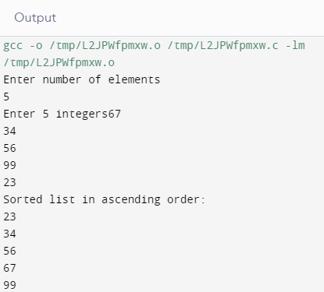
Example in C programming Code
{
swap = array[d];
array[d] = array[d+1];
array[d+1] = swap;
}
}
}
printf("Sorted list in ascending order:\n");
for (c = 0; c < n; c++)
printf("%d\n", array[c]);
return 0;
}

Slide 18
Selection Sort
Selection Sort: The selection sort improves on the bubble sort by
making only one exchange for every pass through the list. In order to do
this, a selection sort looks for the largest value as it makes a pass and,
after completing the pass, places it in the proper location. As with a
bubble sort, after the first pass, the largest item is in the correct place.
After the second pass, the next largest is in place. This process
continues and requires n−1n−1 passes to sort n items, since the final
item must be in place after the (n−1)(n−1) st pass.
Following figure shows the entire sorting process. On each pass, the
largest remaining item is selected and then placed in its proper location.
The first pass places 93, the second pass places 77, the third places 55,
and so on.

Slide 19
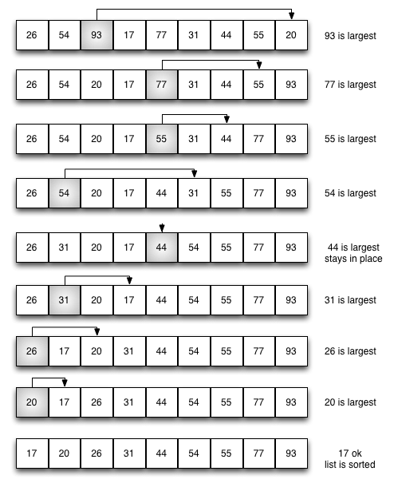
Selection Sort Diagram

Slide 20
Example in C programming Code
#include<stdio.h>
void main()
{
int a[100],n, i, j, min, temp;
clrscr();
printf("\n Enter the Number of Elements: ");
scanf("%d",&n);
printf("\n Enter %d Elements: ",n);
for(i=0;i<n;i++)
{
scanf("%d",&a[i]);
}
for(i=0;i<n-1;i++)
{
min=i;

Slide 21
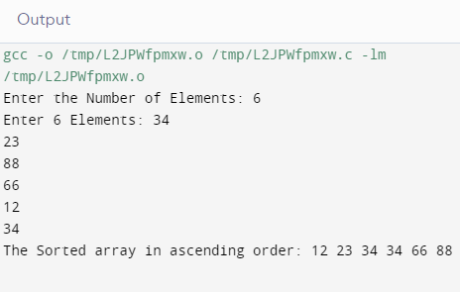
Example in C programming Code
for(j=i+1;j<n;j++)
{
if(a[min]>a[j])
min=j;
}
if(min!=i)
{
temp=a[i];
a[i]=a[min];
a[min]=temp;
}
}
printf("\n The Sorted array in ascending order: ");
for(i=0;i<n;i++)
{ printf("%d ",a[i]);
}

Slide 22
In Linear Search, the list or array is traversed sequentially and every element is checked.
In Binary Search, sorted array by repeatedly dividing the search interval in half.
Binary Search, search a sorted array by repeatedly dividing the search interval in half
SUMMARY
Bubble Sort, works by swapping adjacent elements if they are in the wrong order.
The selection sort improves on the bubble sort by making only one exchange for every pass through the list.

Slide 23
UTILISE YOUR KNOWLEDGE TO ANSWER
1. What is an internal sorting algorithm? a) Algorithm that uses tape or disk during the sort b) Algorithm that uses main memory during the sort c) Algorithm that involves swapping d) Algorithm that are considered ‘in place’
2.Which of the following is not an advantage of optimised bubble sort over other sorting techniques in case of sorted elements? a) It is faster b) Consumes less memory c) Detects whether the input is already sorted d) Consumes less time
3. Where is linear searching used? a) When the list has only a few elements b) When performing a single search in an unordered list c) Used all the time d) When the list has only a few elements and When performing a single search in an unordered list
Let us see how much you have learned from the lecture and how effectively you can apply your knowledge…!!

Slide 24
UTILISE YOUR KNOWLEDGE TO ANSWER
4.Which of the following is not a stable sorting algorithm? a) Insertion sort b) Selection sort c) Bubble sort d) Merge sort
5 Which of the following is not an application of binary search? a) To find the lower/upper bound in an ordered sequence b) Union of intervals c) Debugging d) To search in unordered list
Let us see how much you have learned from the lecture and how effectively you can apply your knowledge…!!

Slide 25
REFERENCES
Book References:
[1] Zed A. Shaw, Learn C the Hard Way’
[2] https://en.wikibooks.org/wiki/C_Programming
Vedio Lecture: https://nptel.ac.in/courses/106/106/106106133/
https://freevideolectures.com/course/4563/nptel-problem-solving-through-programming-in-c/45
https://freevideolectures.com/course/4563/nptel-problem-solving-through-programming-in-c/31
Websites: https://runestone.academy/runestone/books/published/pythonds/SortSearch/toctree.html
http://pages.cs.wisc.edu/~bobh/367/SORTING.html
BOOKS
WEBSITES
COURSES

Slide 26

THANK YOU

